Slide 1
COURSERA CAPSTONE PROJECT
Battle of the Neighborhoods By Yvette Janecek 2019

Slide 2
Section Alpha: Introduction
Description of Problem:
A couple has decided to relocate within the United States. They have created a list of requirements. This list includes a population range and a few community amenities
population range of under 75,000
a grocery store, a library
a post office
a gym or outdoor recreation
restaurants.
I am tasked with determining the cities and towns which fall within this desirable range.

Slide 3
Section Beta: Data
Data will be acquired from the U.S. Census Bureau to identify communities within the desired population range. (This product uses the Census Bureau Data API but is not endorsed or certified by the Census Bureau.)
These metropolitan and micropolitan areas will then be passed through the Google Maps API in order to geocode each location by latitude and longitude.
Along the way, any missing data will be removed.
These coordinates will then be used in the Foursquare API, along with the venue categories selected by the couple, in order to acquire information regarding community amenities for each location.
Lastly, these will be mapped to aid in visualization.

Slide 4
Section Gamma: Methodology
Data from the U.S. Census Bureau was initially loaded using Census Bureau Data API. This data included all metropolitan and micropolitan areas and their population information from 2018.
This data was cleaned then reduced to areas with a population less than or equal to 75,000.
The metropolitan and micropolitan areas, or cities, were passed through the Google Maps API in order to acquire latitude and longitude for each city.
Once this was done, the latitude and longitude coordinates were passed through the Foursquare API along with the categories IDs identified by the couple as significant.

Slide 5
Section Delta: Results
The resulting data shows 226 locations which are home to one or more amenities requested by the couple, and thus, are locations of interest to the couple. These locations have been organized to show the cities with the most amenities first. The top twenty-five locations are mapped below.

Slide 6
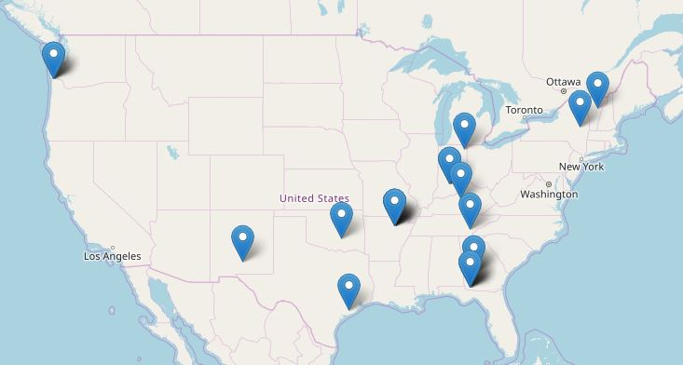

Slide 7
Section Epsilon: Discussion
The data has been organized to include cities and towns with a population range of under 75,000 and with the amenities, of a grocery store, a library, a post office, a gym or outdoor recreation, and restaurants. The top twenty-five cities and towns which fall within this desirable range are shown below.

Slide 8
 | City | State | Latitude | Longitude | Venue | Category
0 | Ada | OK | 34.774531 | -96.678345 | House of Health | Food
1 | Alamogordo | NM | 32.899532 | -105.960265 | Roswell Baking Co | Bakery
2 | Americus | GA | 32.072386 | -84.232688 | Terri's Market and Eatery | Food
3 | Americus | GA | 32.072386 | -84.232688 | J J's Wings & Things | Burger Joint
4 | Amsterdam | NY | 42.937745 | -74.190356 | Riverside Pizza | Pizza Place
5 | Astoria | OR | 46.187884 | -123.831253 | Midpoint | BBQ Joint
6 | Astoria | OR | 46.187884 | -123.831253 | Yufka | Burrito Place
7 | Astoria | OR | 46.187884 | -123.831253 | Warteg Niki II | Indonesian Restaurant
8 | Athens | TN | 35.442851 | -84.592990 | Dairy Barn | Ice Cream Shop
9 | Auburn | IN | 41.366994 | -85.058858 | Spencerville Easter Star Donut Stand | Donut Shop
10 | Decatur County | GA | 30.903800 | -84.575470 | Makan | Asian Restaurant
11 | Bainbridge | GA | 30.903800 | -84.575470 | Yuki Express Japanese Restaurant | Japanese Restaurant
12 | Decatur County | GA | 30.903800 | -84.575470 | Southern Sweets Bakery | Bakery
13 | Decatur County | GA | 30.903800 | -84.575470 | Perhaps A Wrap? | Food Truck
14 | Bardstown | KY | 37.809228 | -85.466902 | Harrison-Smith House | Comfort Food Restaurant
15 | Barre | VT | 44.197006 | -72.502049 | Green Mountain Mini Baked | Donut Shop
16 | Batesville | AR | 35.769799 | -91.640972 | Subway | Sandwich Place
17 | Batesville | AR | 35.769799 | -91.640972 | Subway | Sandwich Place
18 | Batesville | AR | 35.769799 | -91.640972 | Fat Jax Catering and Carry Out | Food
19 | Batesville | AR | 35.769799 | -91.640972 | Morningside Coffee House | Food
20 | Batesville | AR | 35.769799 | -91.640972 | Sabor Latino | Food Truck
21 | Bay City | TX | 28.982757 | -95.969402 | Marias Mexican Restaurant | Mexican Restaurant
22 | Bedford | IN | 38.861162 | -86.487215 | Country Barn Cafe (early bird) | American Restaurant
23 | Bedford | IN | 38.861162 | -86.487215 | El Nacho Del Burrito Mexican Grill | Burrito Place
24 | Bedford | IN | 38.861162 | -86.487215 | Long John Silver's | Seafood Restaurant

Slide 9
Section Zeta: Conclusion
In conclusion, the couple has several options for relocation, which addresses their needs. They should be able to find a new place to live. I wish them the best.

Slide 10
Additional Information, including code, can be found via the following link.
https://github.com/yvettejanecek/Coursera_Capstone

